Slide 1


Eleven Hackathon / X-HEC
Construction site analysis
using Computer Vision techniques
To the attention of Eleven Strategy & Vinci construction
07/10/2020

Slide 2
AGENDA
Presentation
Problem
Solution
Demo

Slide 3
AGENDA
Presentation
Problem
Solution
Demo

Slide 4





Our team of business and technical professionals to address your project
Thomas de Mareuil
Data Scientist Consultant
Computer Vision Expert
Arthur Ducasse
Senior Strategy Consultant
Paul-Emile Dugnat
Data Scientist Consultant
Computer Vision Expert
Tommy Tran
Deployment Strategist
Etienne Windels
Industry Expert Consultant

Slide 5
AGENDA
Presentation
Problem
Solution
Demo

Slide 6
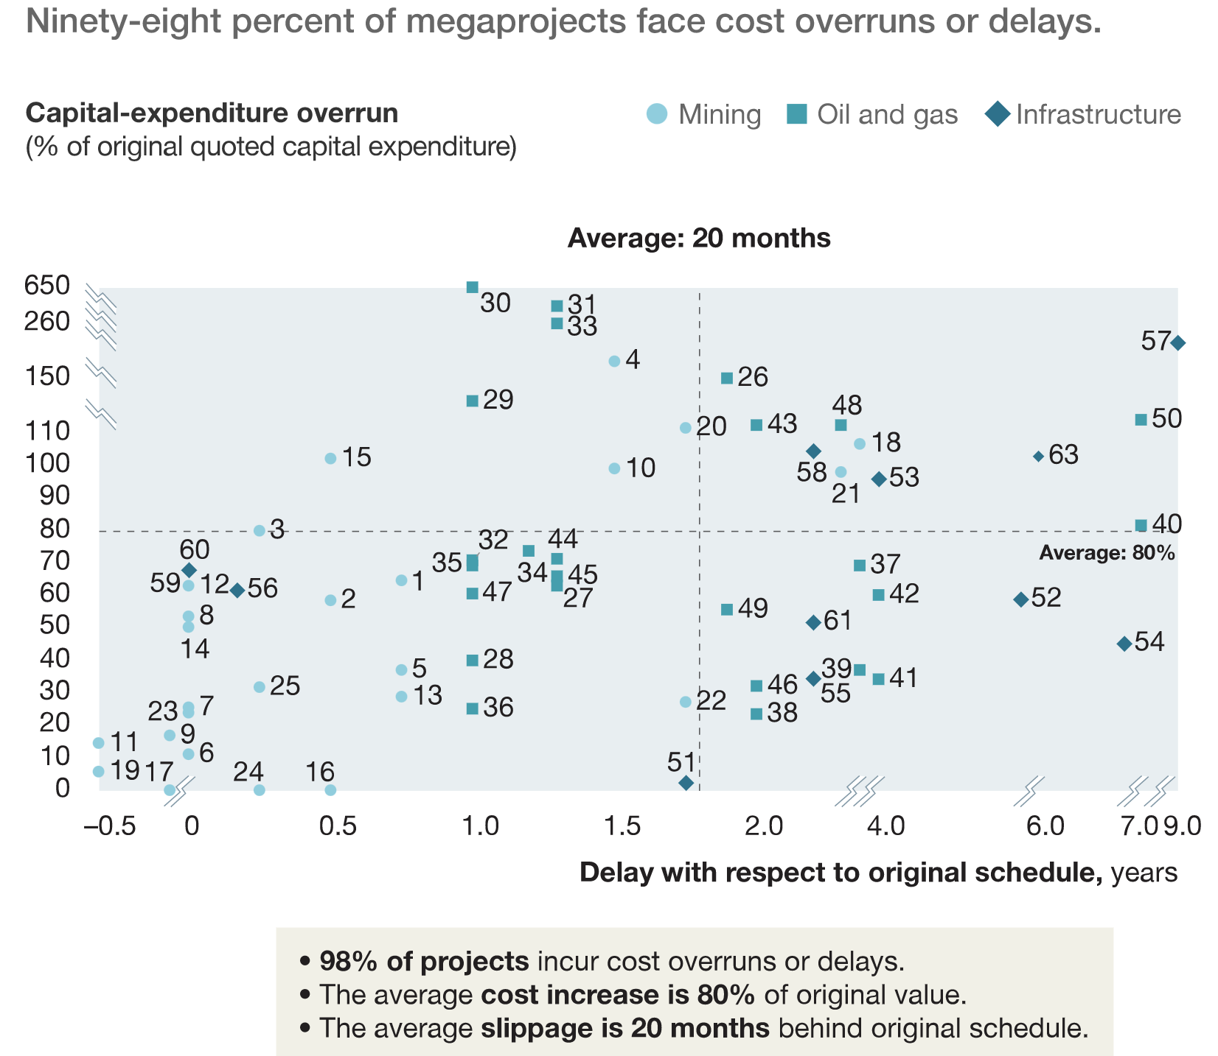
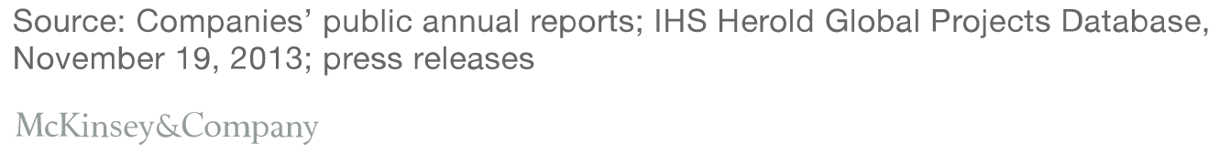
98% of construction projects face cost overruns or delays, with averages of 20-months delays and 80% cost increase

Slide 7
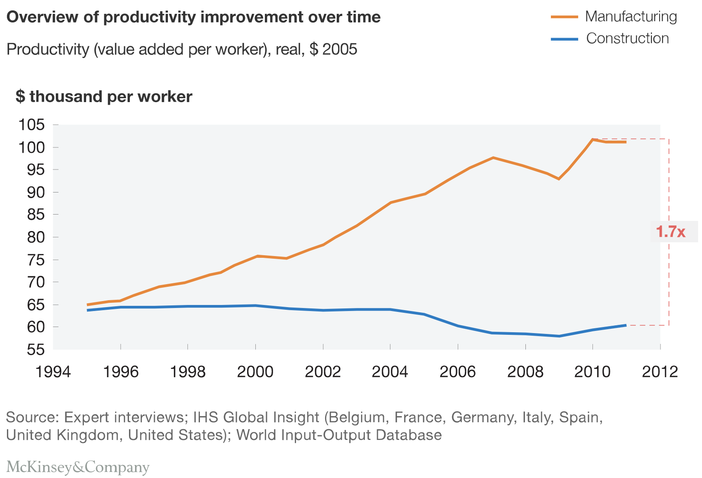
Productivity in construction remained flat since 1995, whereas it nearly doubled in manufacturing

Slide 8


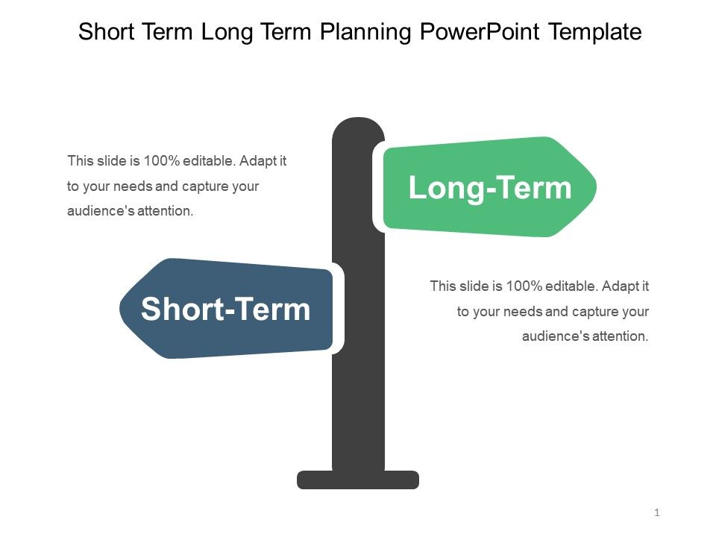
4 key factors of poor productivity that we are addressing
Missed connections
Inadequate communication and data/information flows
Flawed performance management
Poor short-term planning
Need for insightful metrics to drive decision-making and to design adapted strategies for each construction site
Notes:
Poor organisation:
Decision-making and procurement processes do not have the speed and scale required.
Inadequate communication:
Inconsistencies in reporting mean not have a common understanding of how the project is faring at any given time.
Flawed performance management:
Unresolved issues stack up because of lack of communication and accountability.
Missed connections:
There are different levels of planning, from high-end preparation to day-by-day programs. If the daily work is not finished, schedulers need to know—but often don’t—so that they can update priorities in real time.
Poor short - term planning:
Companies are generally good at understanding what needs to happen in the next two to three months, but not nearly so much at grasping the next week or two. The result is that necessary equipment may not be in place.

Slide 9

How to increase productivity on construction sites?
AI can track live:
Workers activity on-site
Tasks assignation to workers
Tasks progress
Notes:
Poor organisation:
Decision-making and procurement processes do not have the speed and scale required.
Inadequate communication:
Inconsistencies in reporting mean not have a common understanding of how the project is faring at any given time.
Flawed performance management:
Unresolved issues stack up because of lack of communication and accountability.
Missed connections:
There are different levels of planning, from high-end preparation to day-by-day programs. If the daily work is not finished, schedulers need to know—but often don’t—so that they can update priorities in real time.
Poor short - term planning:
Companies are generally good at understanding what needs to happen in the next two to three months, but not nearly so much at grasping the next week or two. The result is that necessary equipment may not be in place.

Slide 10

How to increase productivity on construction sites?
AI can track live:
Workers activity on-site
Tasks assignation to workers
Tasks progress
Through a monitoring system you can:
Optimize team organisation to achieve the same amount of work with a reduced workforce
Decrease communications misunderstanding
Train and integrate new workers faster
Notes:
Poor organisation:
Decision-making and procurement processes do not have the speed and scale required.
Inadequate communication:
Inconsistencies in reporting mean not have a common understanding of how the project is faring at any given time.
Flawed performance management:
Unresolved issues stack up because of lack of communication and accountability.
Missed connections:
There are different levels of planning, from high-end preparation to day-by-day programs. If the daily work is not finished, schedulers need to know—but often don’t—so that they can update priorities in real time.
Poor short - term planning:
Companies are generally good at understanding what needs to happen in the next two to three months, but not nearly so much at grasping the next week or two. The result is that necessary equipment may not be in place.

Slide 11

How to increase productivity on construction sites?
AI can track live:
Workers activity on-site
Tasks assignation to workers
Tasks progress
Through a monitoring system you can:
Optimize team organisation to achieve the same amount of work with a reduced workforce
Decrease communications misunderstanding
Train and integrate new workers faster
Resulting in key business improvements:
Better allocated workforce and thus reduced costs
Reduced projects downtime thanks to better planning
Delay prevention thanks to improved productivity
Notes:
Poor organisation:
Decision-making and procurement processes do not have the speed and scale required.
Inadequate communication:
Inconsistencies in reporting mean not have a common understanding of how the project is faring at any given time.
Flawed performance management:
Unresolved issues stack up because of lack of communication and accountability.
Missed connections:
There are different levels of planning, from high-end preparation to day-by-day programs. If the daily work is not finished, schedulers need to know—but often don’t—so that they can update priorities in real time.
Poor short - term planning:
Companies are generally good at understanding what needs to happen in the next two to three months, but not nearly so much at grasping the next week or two. The result is that necessary equipment may not be in place.

Slide 12
Presentation
Problem
Solution
Demo
AGENDA

Slide 13
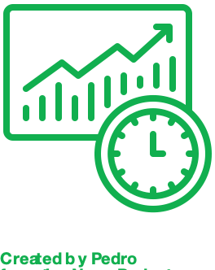


Chronsite: improving productivity on construction site with AI
On average, chrono-analysis can increase productivity by 20 to 30%
Simplify, automate and generalize chrono- analysis thanks to AI solutions in order by making it scalable
V
However, these are time-consuming and expensive so they remain occasional
Provide operational staff with real-time KPIs to improve performance management and to adapt short-term strategies

Slide 14



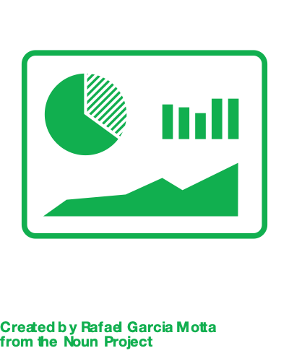

An automatic monitoring solution based on deep learning and computer vision techniques
A smooth analysis workflow using deep learning...
1
2
3
4
Data Acquisition
Detection Model
Analysis Model
Reporting
...resulting in valuable insights for decision-making:
Tools based on computer vision
Automatic creation of business data
Real-time indicators
Direct and easy access to site monitoring

Slide 15
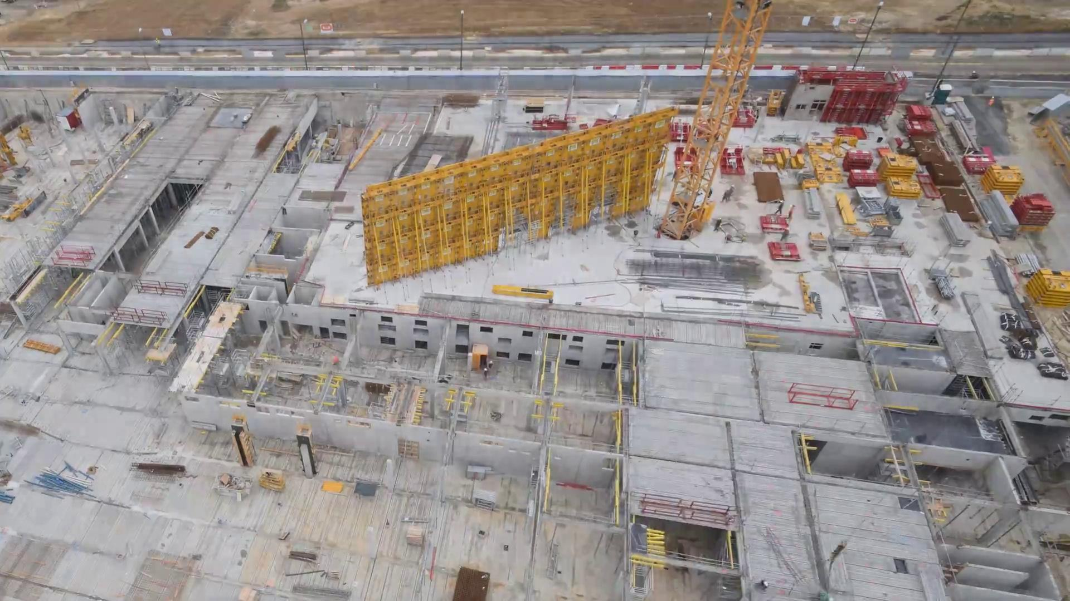
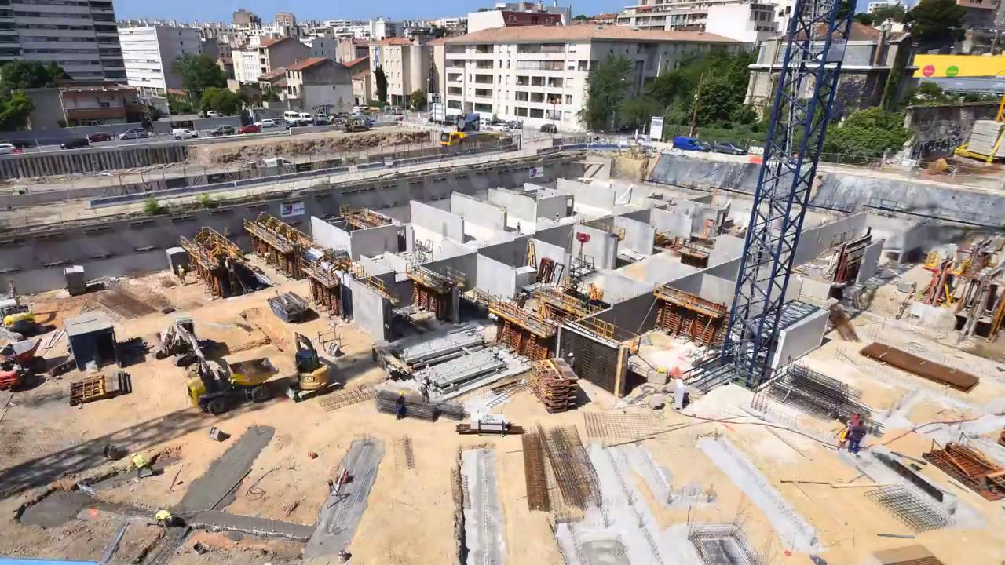
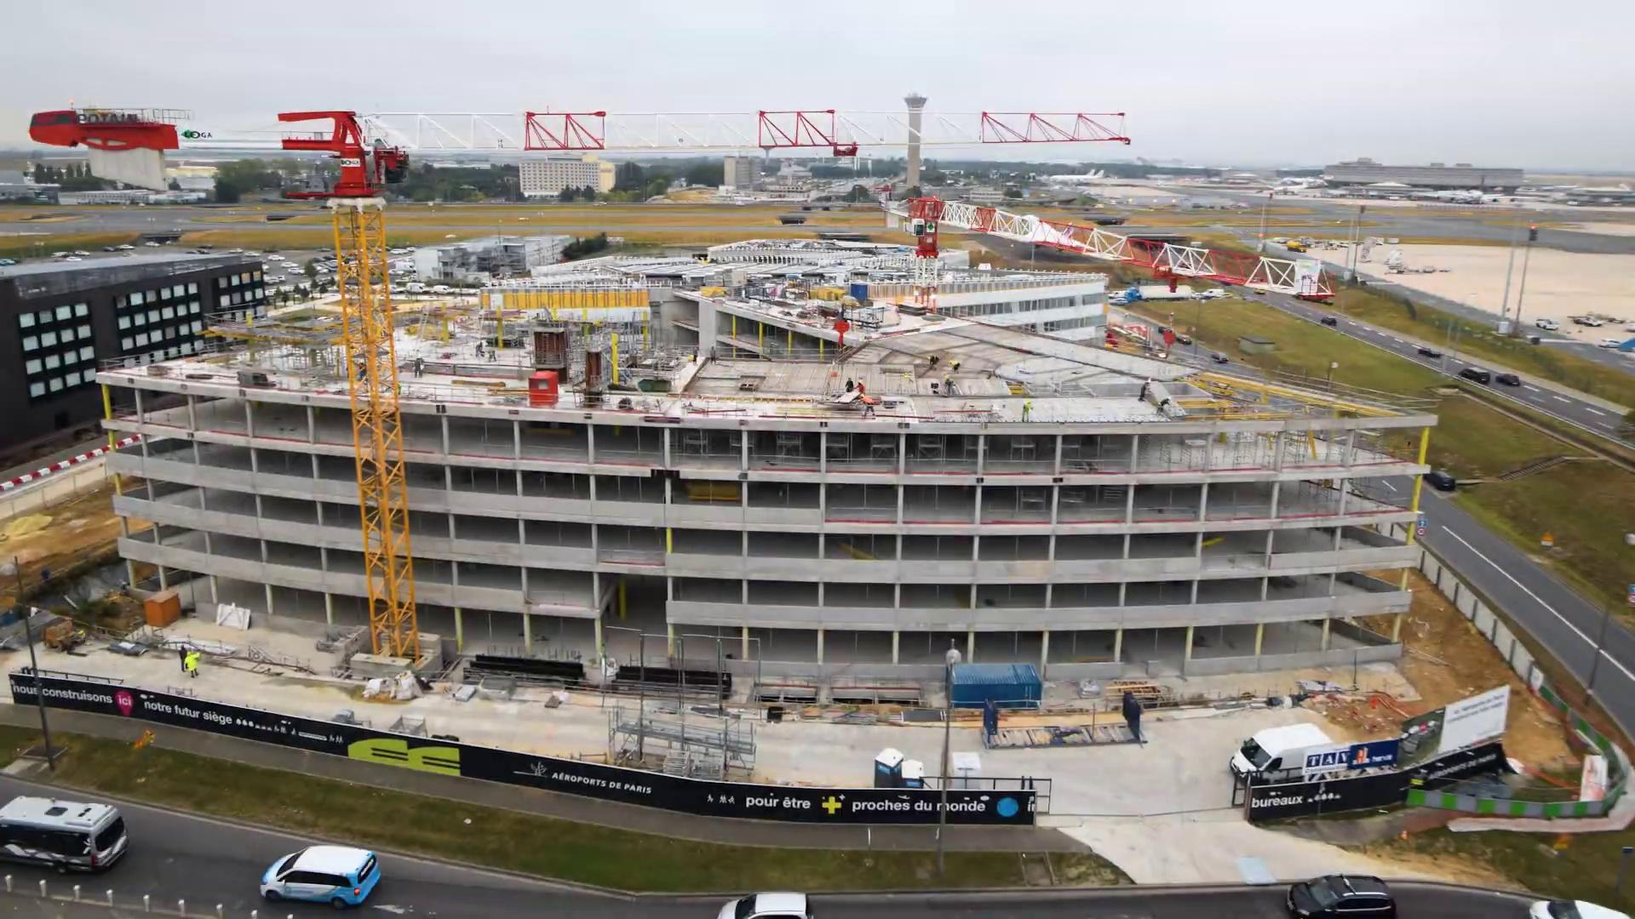
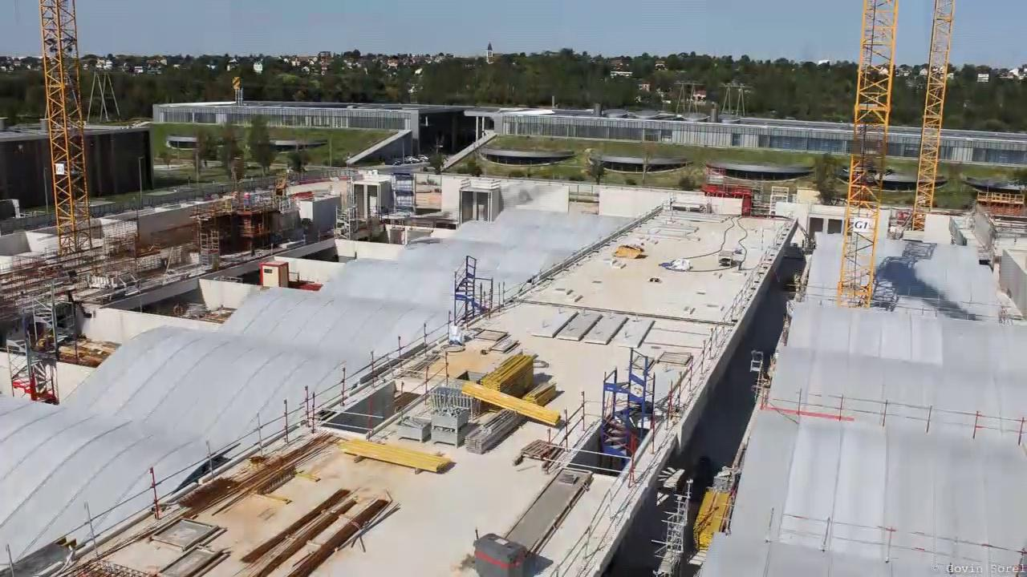
Data
Acquisition
Leveraging under-used construction site video- surveillance data to automate analysis
1
Our preliminary solution uses existing data from several construction sites
Images are shot from diverse distances and perspectives, which makes the solution flexible and scalable to most construction sites
Allows for automatic and real-time insights

Slide 16
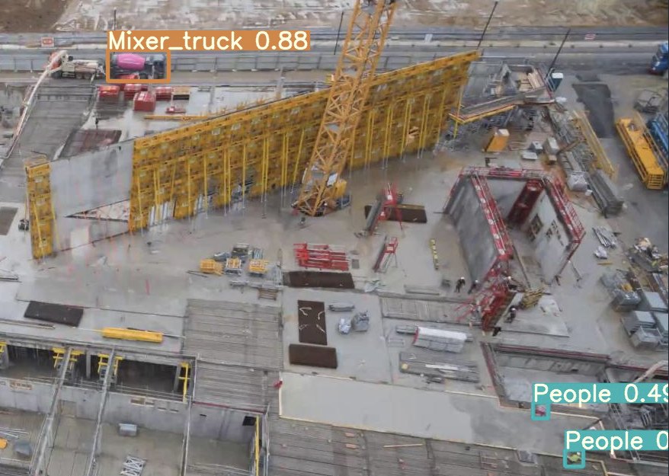
Detection
Model
Implementing a state-of-the-art object detection model via transfer learning
2
We implemented 2 different models to detect relevant items on construction sites:
Object detection model
Detection of people and mixer trucks
YOLO object detection model (bounding boxes around object)
Data Augmentation using real-life transforms (fog, rain, brightness)
Performance improved thanks to “COCO” pre-trained weights
75% of people are detected, 90% of mixer trucks
Notes:
Mixer_truck
Vertical_formwork
People
Concrete_pump_hose

Slide 17
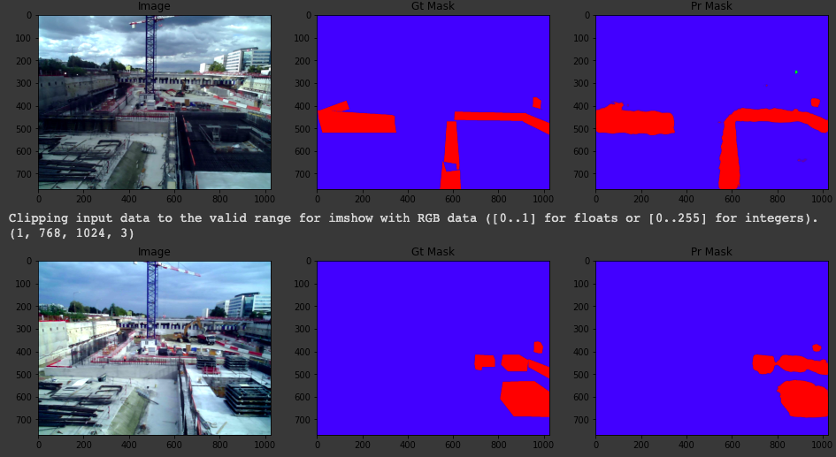
Detection
Model
Performing state-of-the-art image segmentation based on the latest deep learning research
2
We implemented 2 different models to detect relevant items on construction sites:
Image segmentation model
Detection of formworks and concrete pumps, pixel by pixel
Similar data augmentation techniques
UNet image segmentation model (masks corresponding to object)
Developed originally for medical image analysis - very flexible structure
Notes:
Mixer_truck
Vertical_formwork
People
Concrete_pump_hose

Slide 18
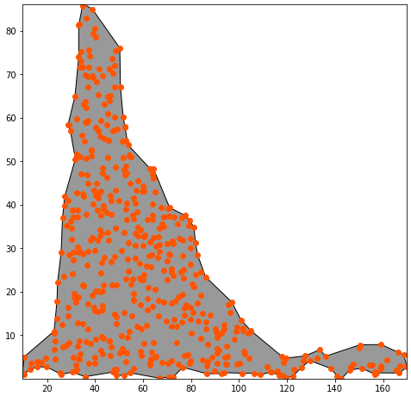
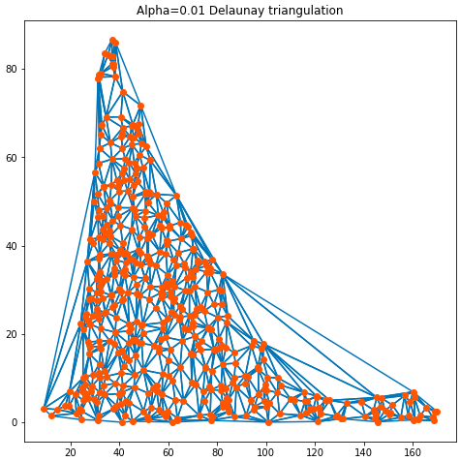
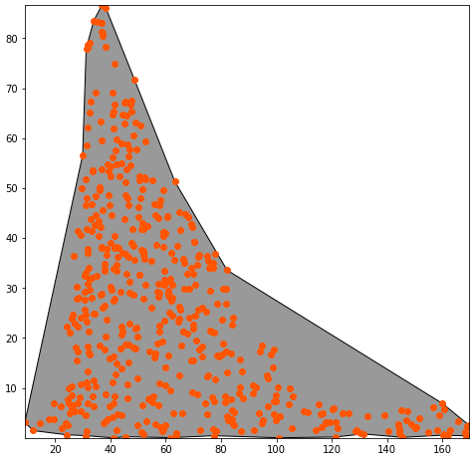
Detection
Model
Post-processing of masks allows to improve image segmentation performance
2
We applied advanced geometry analysis techniques to post-process the objects detected by the image segmentation model:
Ouputs of segmentation models are often irregular (here, a formwork area)
Delaunay triangulation allows to smoothen the edges (concave hull) of the detected polygons
As a result, detected polygons are closer to real-life objects.
Notes:
Mixer_truck
Vertical_formwork
People
Concrete_pump_hose

Slide 19
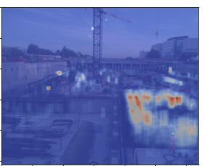
Analysis
Model
Monitoring construction site movements to draw insights in real-time
3
Worker & machine heatmap
With Python, we are able to analyse where workers spend the most time on construction site - here, it’s around the vertical formworks used for the concreting task
Daily run of analysis pipeline could improve short term management and productivity, site-by-site
Notes:
Mixer_truck
Vertical_formwork
People
Concrete_pump_hose

Slide 20
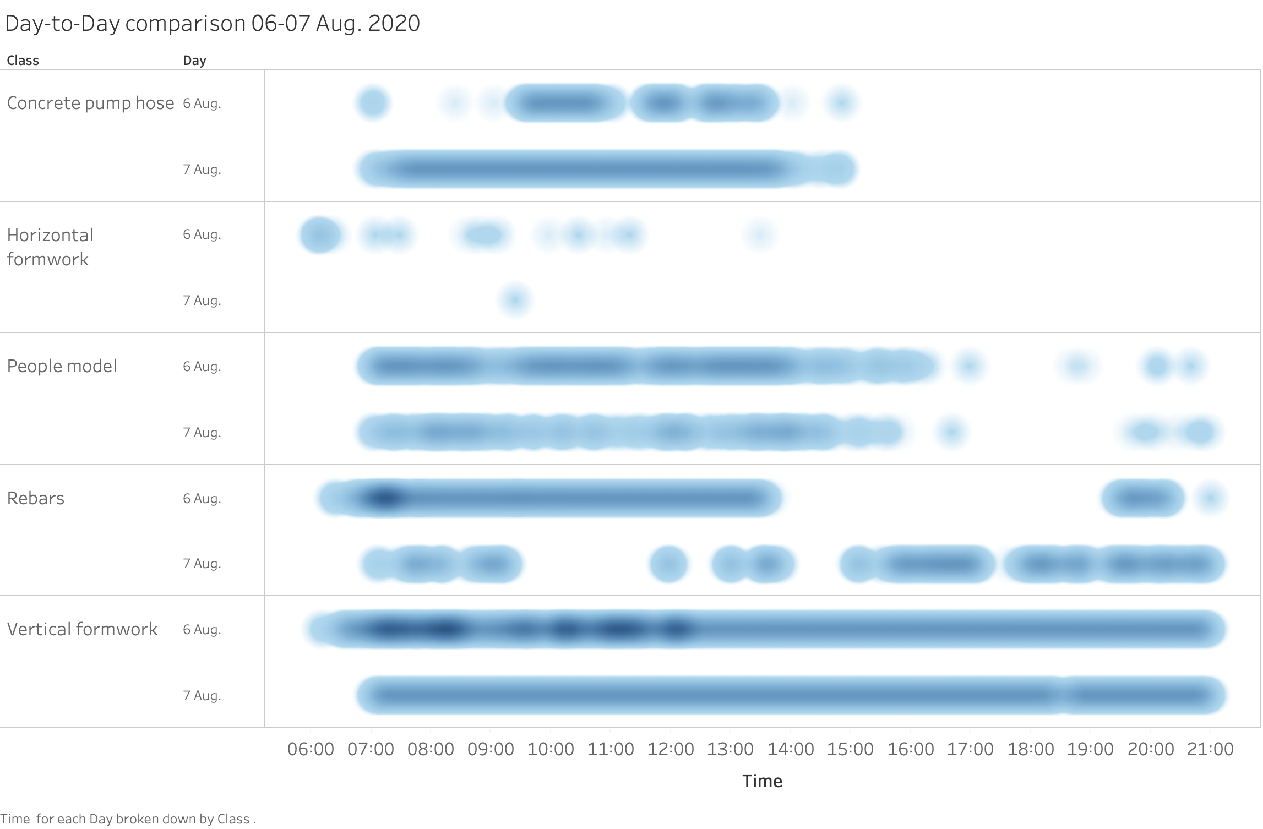
Analysis
Model
Short-term monitoring of construction site
3
Daily and weekly reports
Enabling management to see at a glance if there are any difficulties on the observed construction site
Notes:
Mixer_truck
Vertical_formwork
People
Concrete_pump_hose

Slide 21



Reporting
A cost-light and scalable reporting pipeline...
4
CCTV
Deep Learning model
Real time dashboard
Scalable real time analysis of multiple construction sites: the marginal cost of a new setup after the base pipeline is extremely low.
CCTV: 250€ one-time purchase and setup
Image storage: 10€ per month (AWS S3)
Model inference: 100€ per month (AWS Machine Learning)

Slide 22

Reporting
...Based on a number of KPIs to drive performance
4
Some metrics from videos of your construction site between the 6th and 7th August:
On average 4 workers are continuously working with the concreting pump while 2 are actually needed
6 hours to complete a concreting task on average
Some metrics from videos of your construction site between the 6th and 7th August:
On average 4 workers are continuously working with the concreting pump while 2 are actually needed
6 hours to complete a concreting task on average
→ 12 hours productivity loss → 87k€ lost a year on concreting operations

Slide 23

Reporting
...Based on a number of KPIs to drive performance
4
Some metrics from videos of your construction site between the 6th and 7th August:
On average 4 workers are continuously working with the concreting pump while 2 are actually needed
6 hours to complete a concreting task on average
→ 12 hours productivity loss → 87k€ lost a year on concreting operations
Projected on-the-fly metrics to be measured as part of Chronsite:
Idle time ratio: (Production downtime / total labor hours)
Activity ratio: (Expected hours needed to produce output / actual hours needed)
Labor capacity: (Actual hours worked / total budgeted labor hours)
Percentage of equipment downtime
Percentage of labor downtime

Slide 24
Presentation
Problem
Solution
Demo
AGENDA

Slide 25
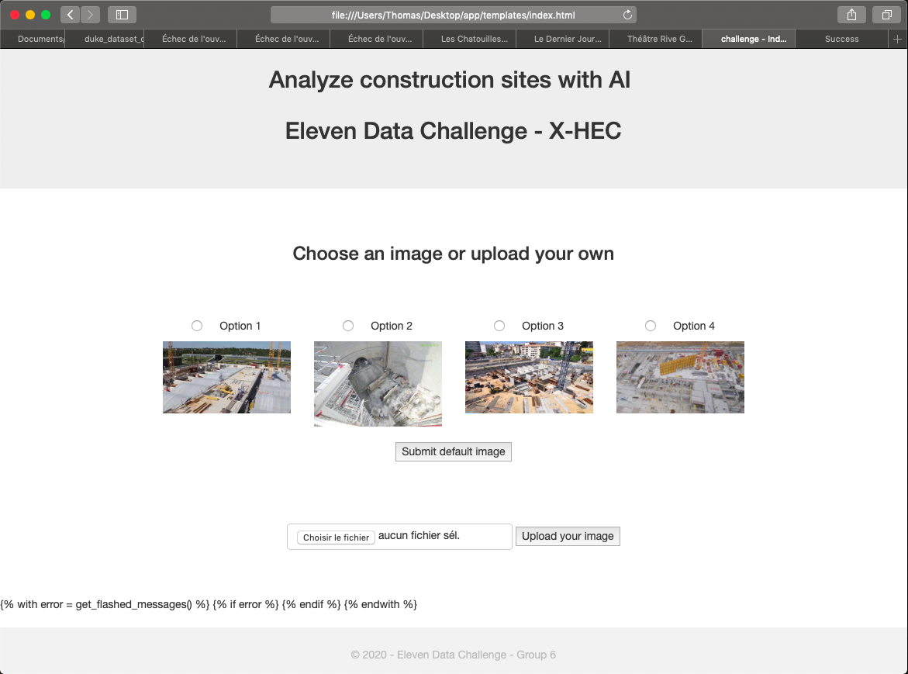
Let’s talk to the model ! Presenting a simple app interface...
Deep learning can often look like a black box. In order to interact with the model more easily, we built a simple browser app (based on the Python Flask framework).
In a business context, users will not launch a complex model through the command line
For now, this app allows the user to easily run the model on images of his choice
In production, it could be improved by connecting directly to the data sources, construction site by construction site

Slide 26
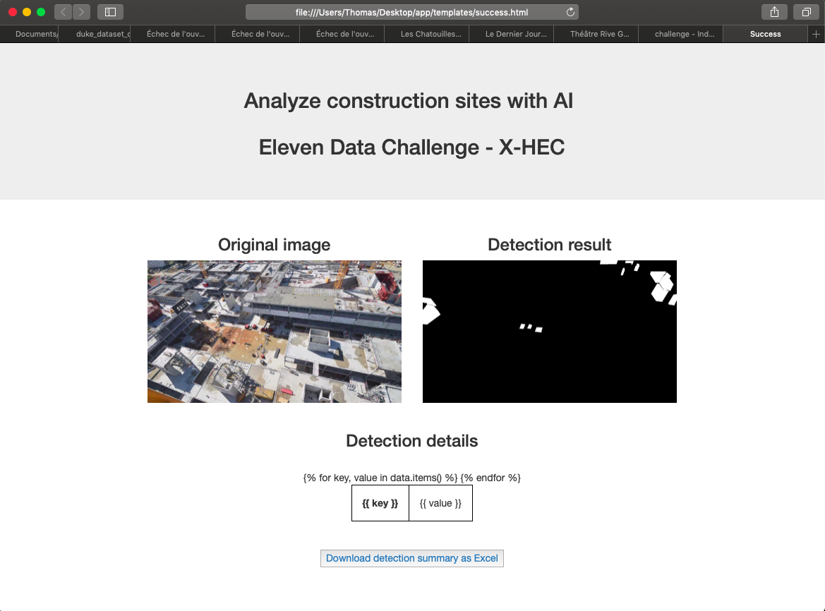
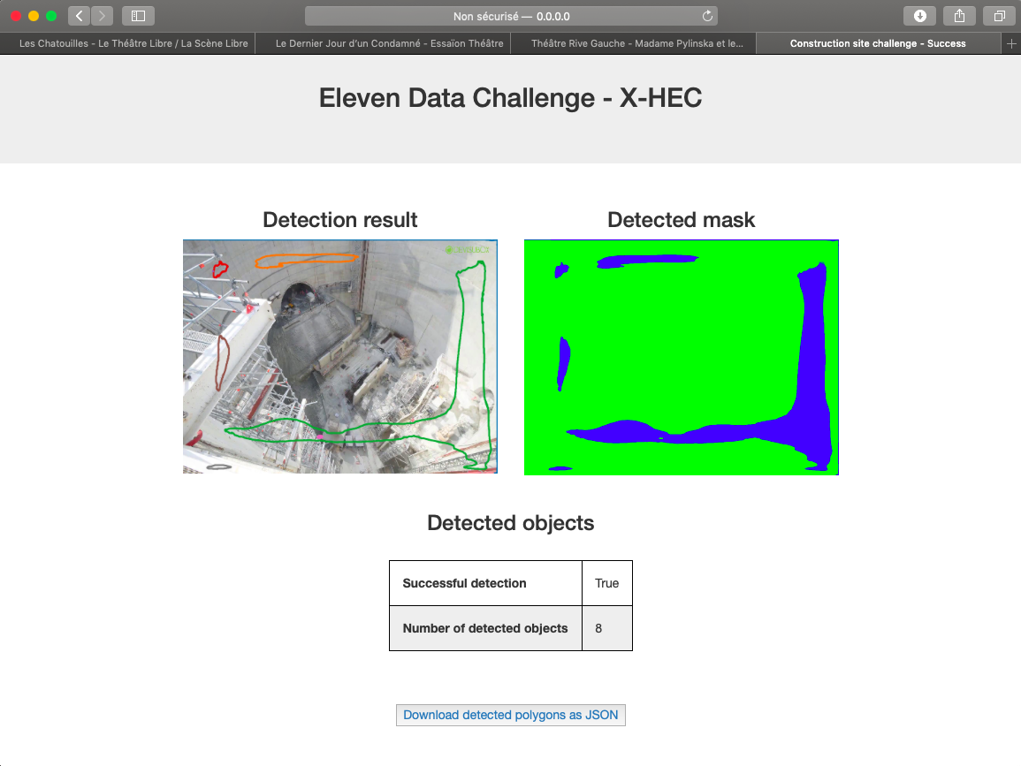
...which could be improved into a smooth end-user platform
For now, on the results page, the detection results are displayed and several insights are provided
When connecting to more data, the interface could include actionable KPIs and dashboards
Could be improved into a more complex app / reporting tool adapted to business needs.

Slide 27


Next steps: Improving our solution to best fit your business needs
Technical improvements are possible over certain aspects of the analysis:
Automated real-time (or daily) computation of KPIs
Automatic model improvement as more training data is periodically gathered
Tool development could also be envisioned to support site monitoring and decision-making:
Develop a reporting tool including alerts and dashboards
Potentially through an app interface, in order to access analysis and drive performance locally.
We stand ready to work with you on designing and implementing the operational phase of the project, next to your business and technical stakeholders.

Slide 28


Thanks!
…Any questions?

Slide 29
Appendix
AGENDA

